Slide 1
Machine learning wine predictions
Dan Bruen, Filipa Correia, Eddy Joseph, Gage petruzello, alec Prostok

Slide 2
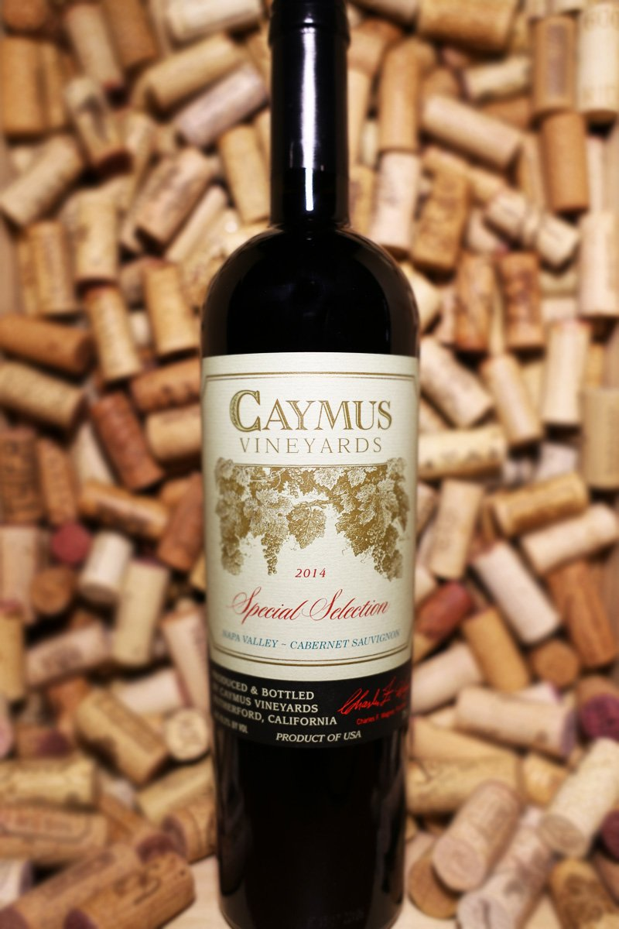
Goals & objectives
Create a machine learning model that analyzes existing wine data to make a classification on high-quality wine.
Develop a descriptive ‘search’ function that allows you to describe a wine you’re seeking and return the ‘quality’ bucket of the wine you’re enjoying.

Slide 3
Existing Data used
We used a data set of over 125,000 wines from 36 different countries.
The data contained information on the various wines’ points, varietal, region and price.
The data set was scraped from ‘wine enthusiast’ magazine.
We parsed our data set down to ~18,000 wines

Slide 4
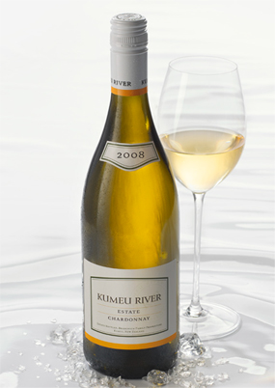
The machine learning model we created
We used a Random Forest Classifier
We used 5 ‘quality’ bins to describe the wine
We also used a count vectorizer on the wine description
Other features we heavily considered were price and country origin
The model had a score of ~94

Slide 5
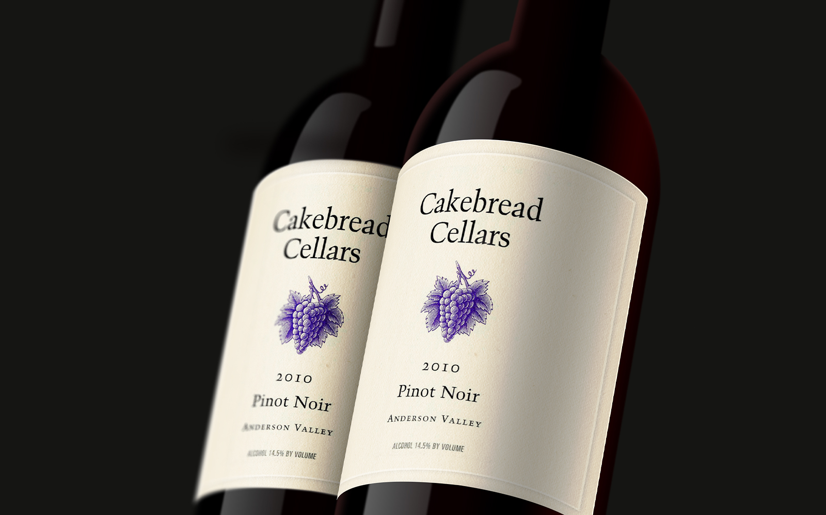
Our process & the challenges we faced
The testing data we used was skewed towards more expensive wine – the lowest rated wine was 80 points (out of a possible 100 points)
We wanted to be able to pull a specific wine or wines from the data set that match your description of the wine you’re looking for.
Our model didn’t

Slide 6
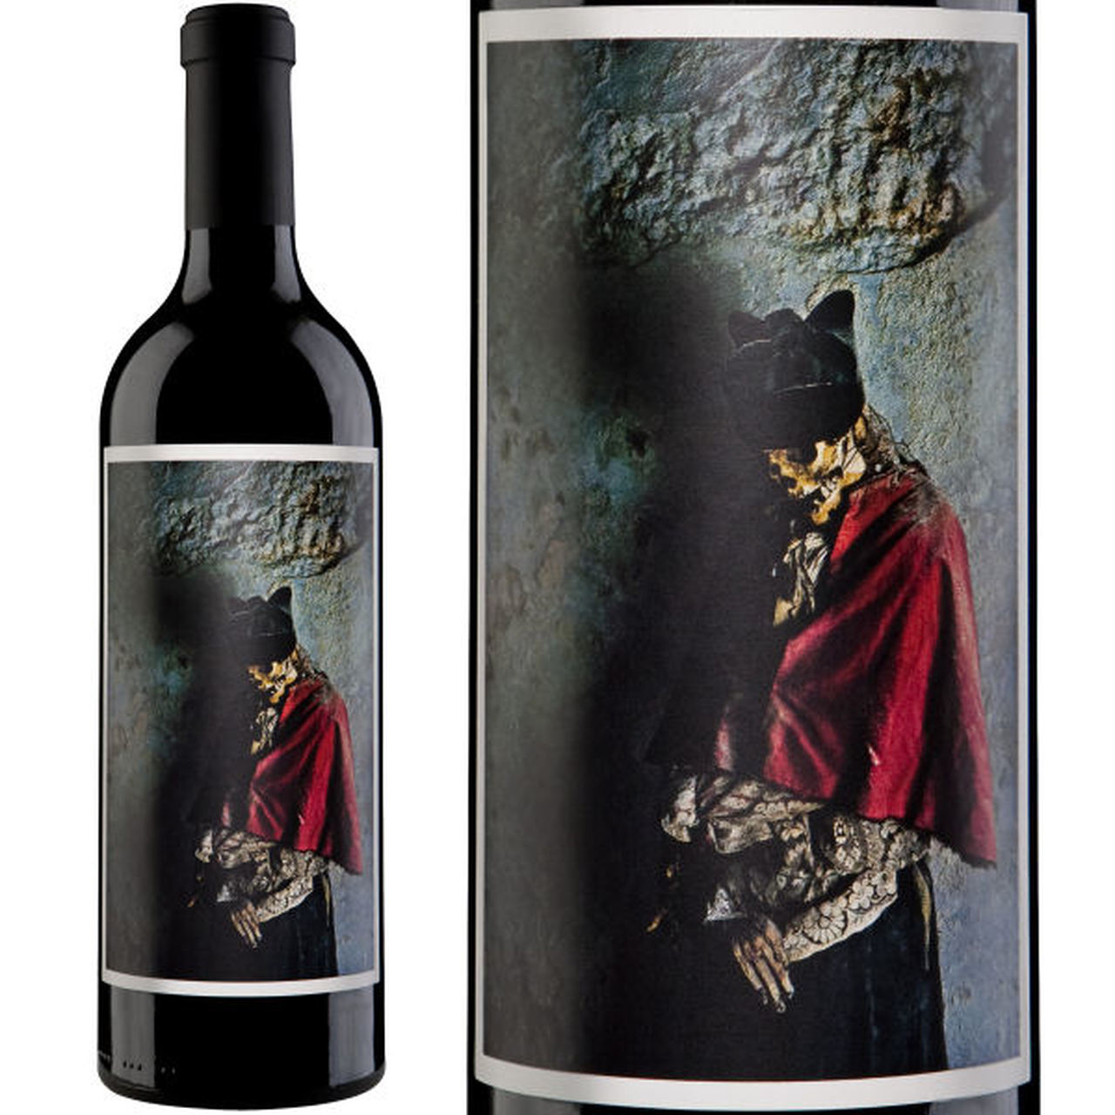
Future improvements
Rather than just vectorizing and binning the wine, we would like to ultimately return specific wines from the data.

